Slide 1
CodeJudge
Paul Schade
Laren Spear
Karthik Mohan Raj
Kathan Vyas

Slide 2
Table of Contents
Problem statement
Our Approach
Database and Schema
Features
Implementation
Final product

Slide 3
Problem Statement
Develop a code judging tool for Texas A&M University.
Instructors can add problems
Students have unlimited attempts
Visible and hidden test cases
Multiple languages

Slide 4
Technologies
Ruby on Rails
Postgres
Docker
Redis
Sidekiq
SCSS
Heroku

Slide 5
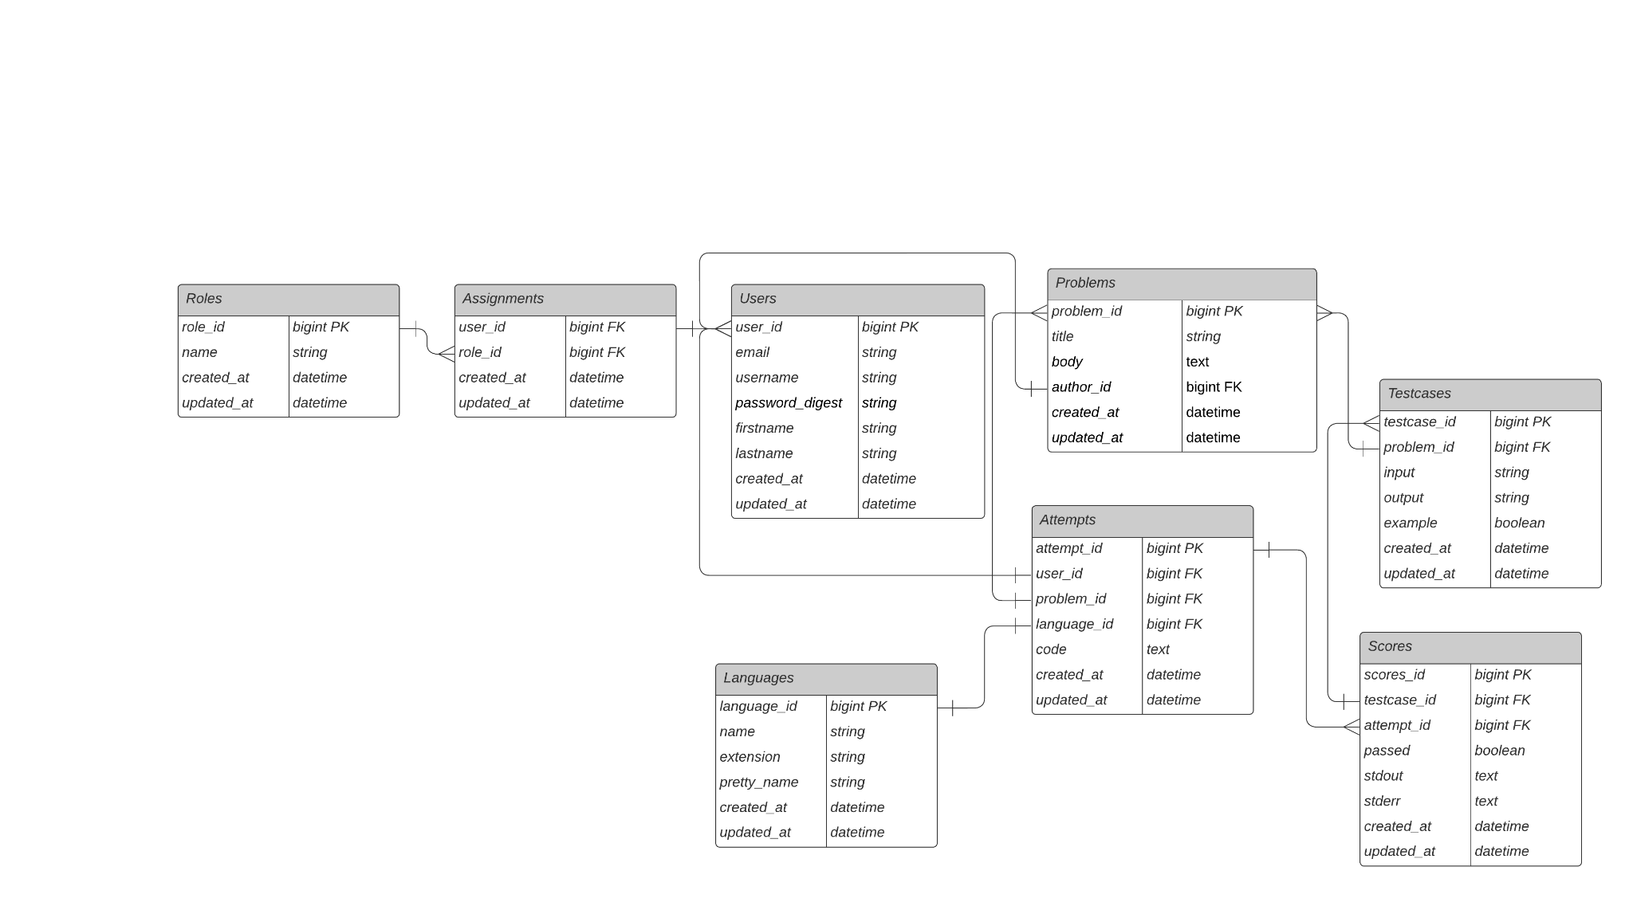
Database Schema

Slide 6

Features: Roles System
Posting problems
Setting test cases
Instructor
Supporting Instructors
Checking test cases
TAs
Answering problems
Attempts
Student

Slide 7
Features: Code and Test Case
Given a problem:
The student answer can be in any one of 39 supported languages
All test cases for a given problem are checked
Students receive a report on passed vs failed test cases
The code is graded asynchronously
The page updates without having to refresh

Slide 8
Features: Authentication
Handled with the Pundit Gem
Allows us to set permissions per method
Boolean function (called policy) to return whether authenticated
Policy is checked before controller action is executed
Can also be used to conditionally show UI elements

Slide 9
Features: Other
Syntax highlighting
Light-Dark theme
Dockerized version
File uploading
Asynchronous code grading

Slide 10
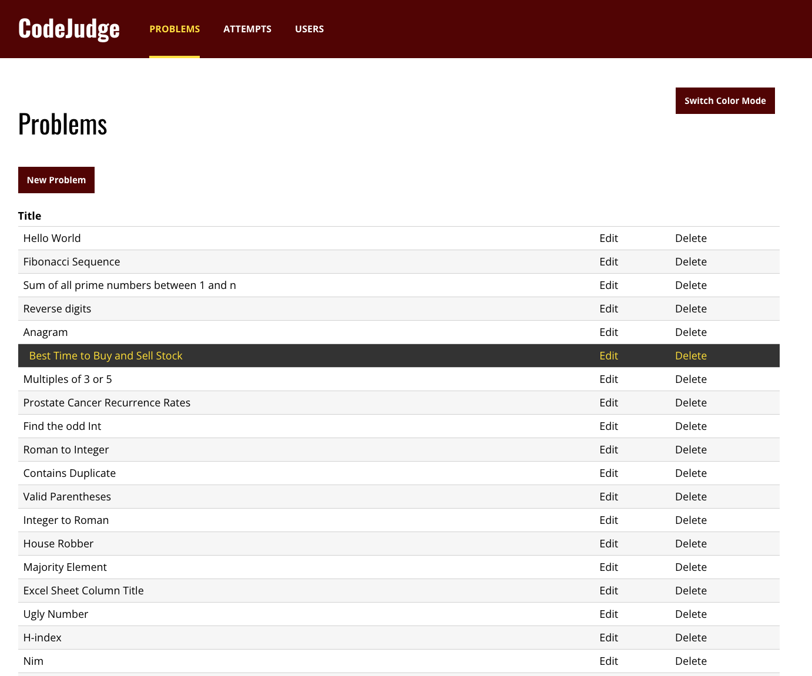
Problems Page

Slide 11
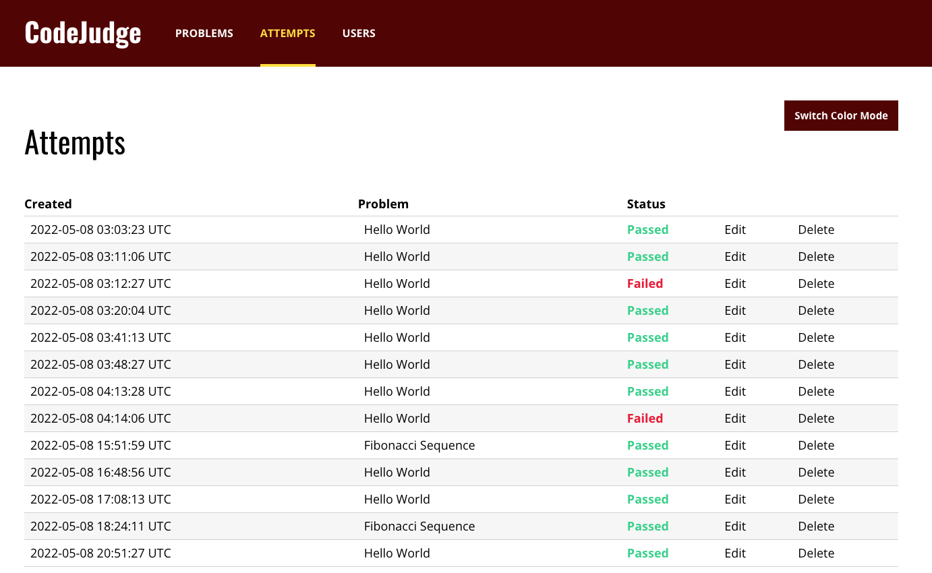
Past Attempts

Slide 12
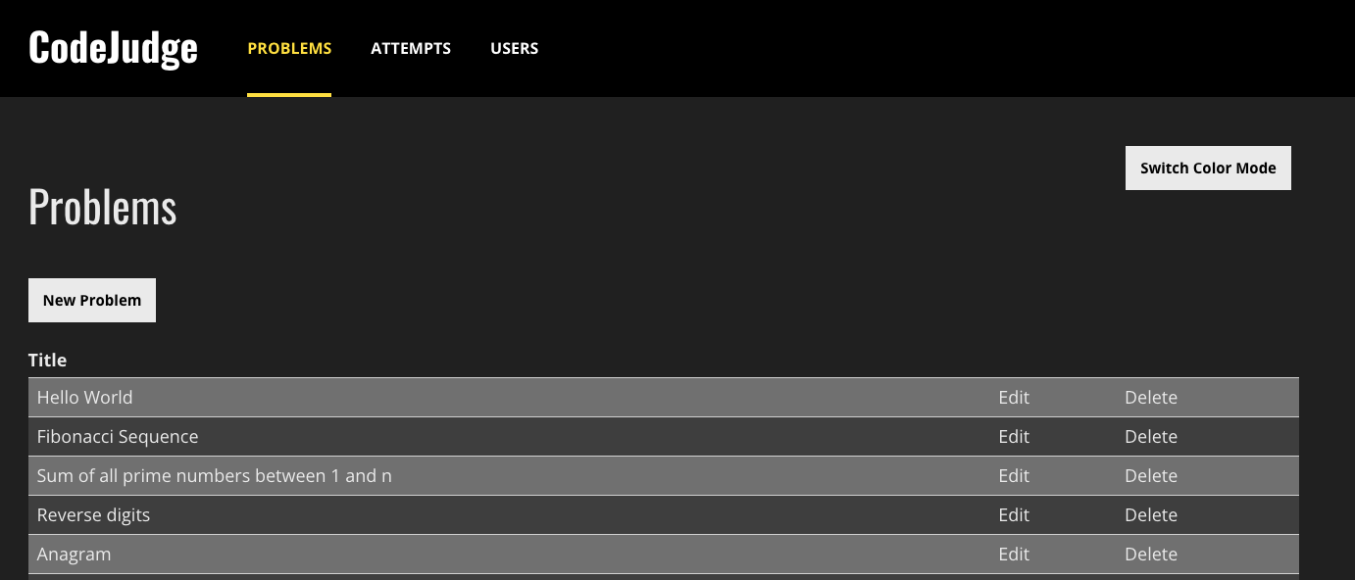
Dark Mode

Slide 13
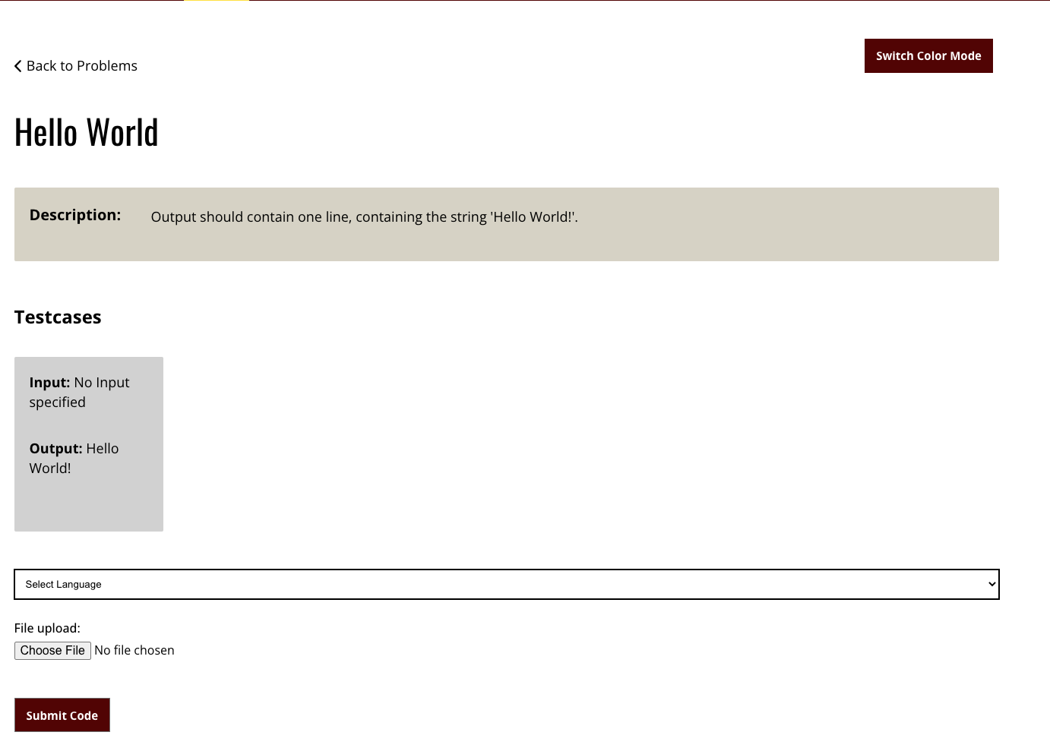
Problem

Slide 14
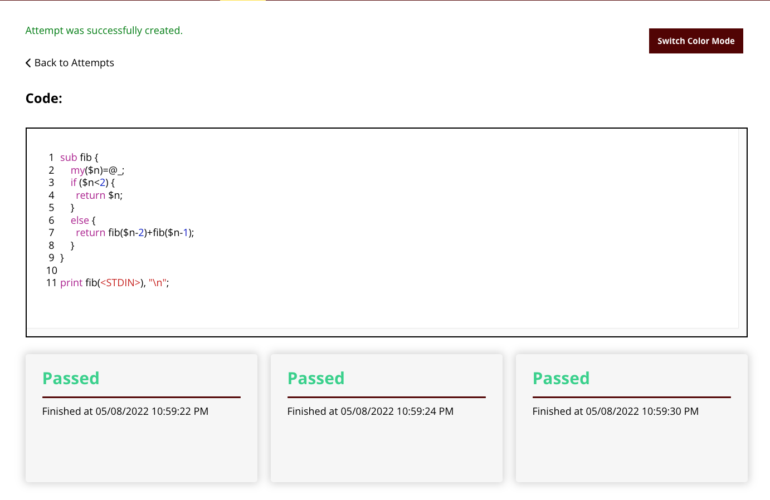
Attempt Page

Slide 15
Lessons Learned
Dockerizing
Setting up cache volumes
ARM vs x86 issues
Chromedriver
The Rails Way
structure.sql → schema.rb
Convention over configuration
Depending on external APIs can be dangerous
Glot.io went down and crippled our site

Slide 16
Thank you!

Slide 17
Our Vision
A code judging platform for A&M
Professors can add problems for students to solve
Professors can add custom test cases
Support for more languages than major platforms

Slide 18
Key Features
Role system (admin, instructor, TA, student)
Instructors can add problems and test cases (either visible or hidden) to problems
Students can solve problems and see past attempts
Submitted code is compiled and run through glot.io API
Results are returned asynchronously
Supports 39 languages
Syntax highlighting & light/dark theme

Slide 19
major use cases

